Slide 1
YOGA FITNESS CULB
Guided By:
Jayanth V Sir
Presented By:
Pranita Lahu Chopade

Slide 2
Content
Introduction of topic
Languages used
Screenshots

Slide 3
Introduction
In have developed static website Yoga Fitness Club.
Why I choose this topic?

Slide 4
Languages Used
HTML
HTML stands for Hyper Text Markup Language
HTML describe the structure of a web page.
HTML element tell the browser how to display the content.

Slide 5
Languages Used
CSS
CSS stands for Cascading Style Sheet.
CSS describe how to HTML element are to be displayed.
CSS saves lot of work . It can control the layout of multiple web pages all at once.

Slide 6
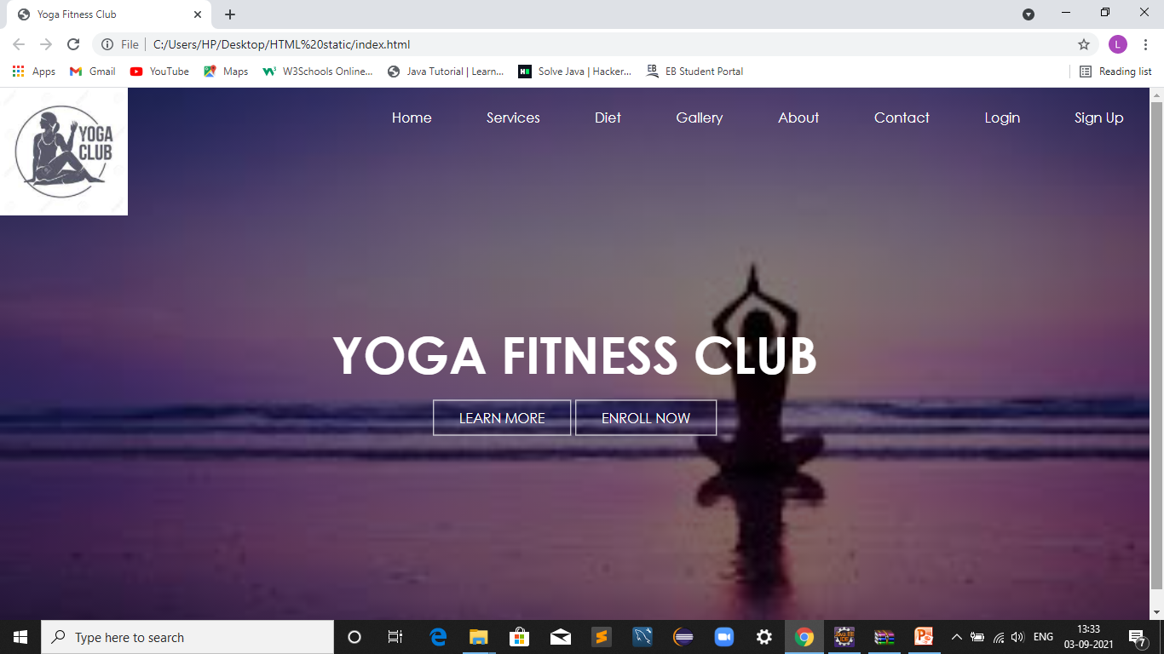
Home Page

Slide 7
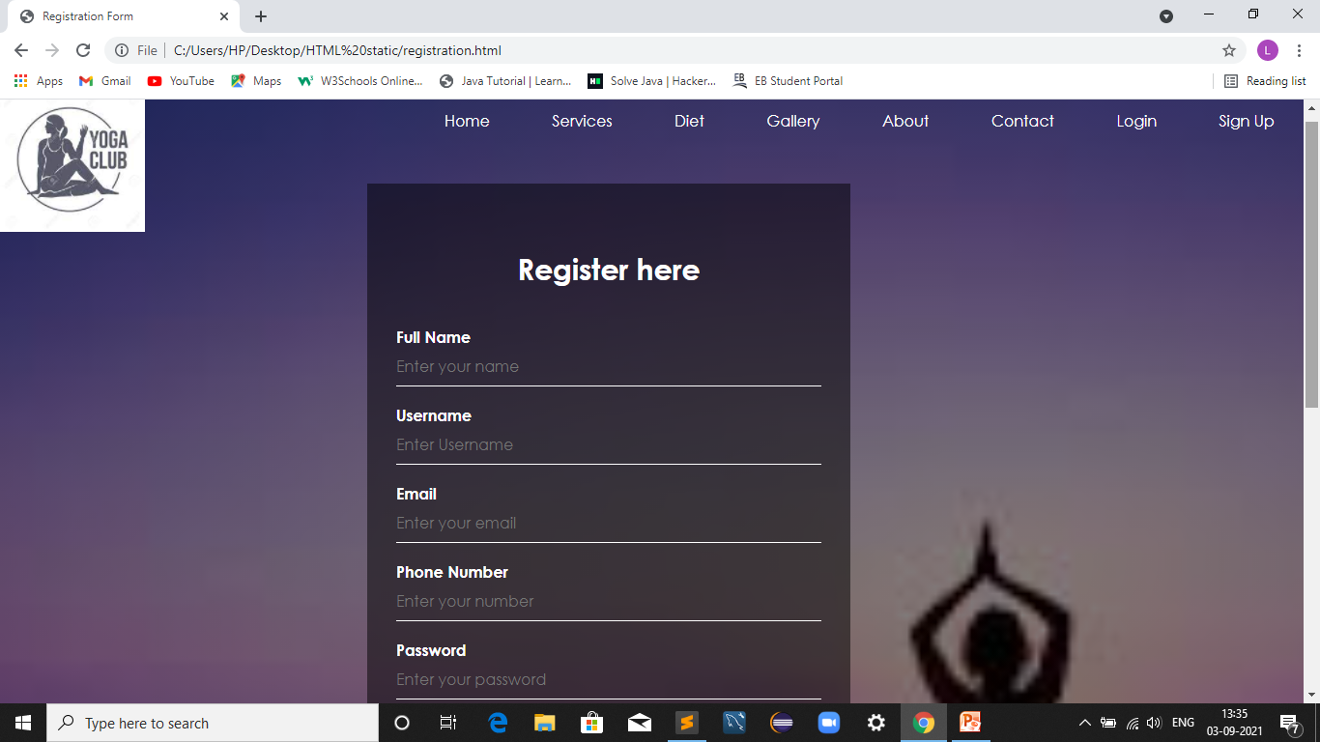
Registration Page

Slide 8
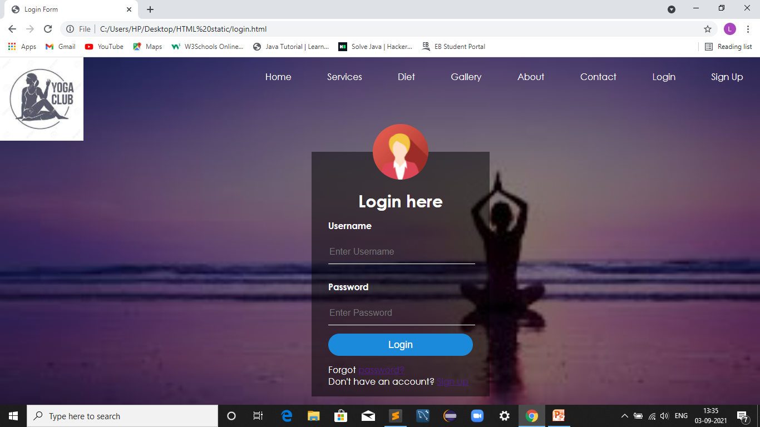
Login Page

Slide 9
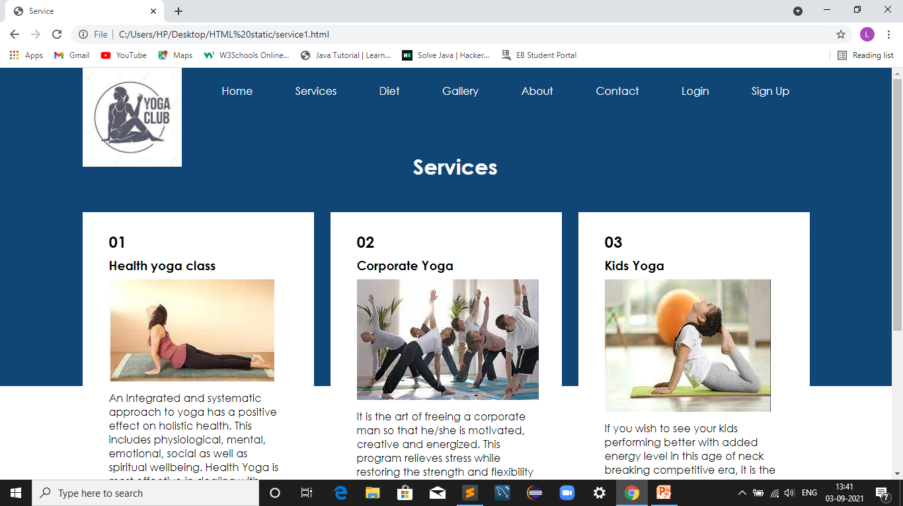
Services Page

Slide 10
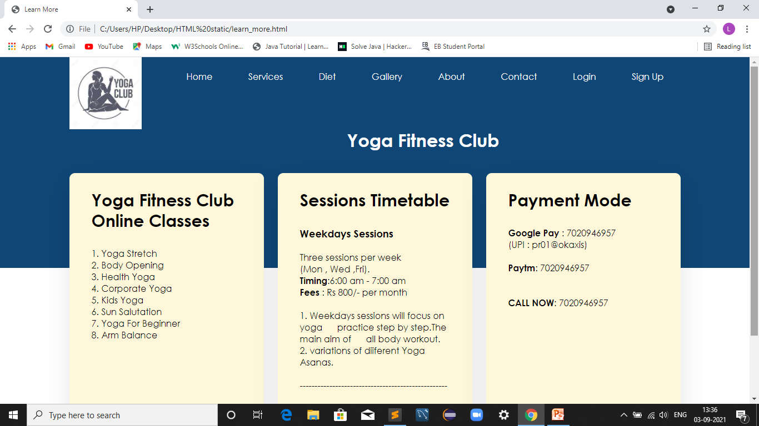
Learn More Page

Slide 11
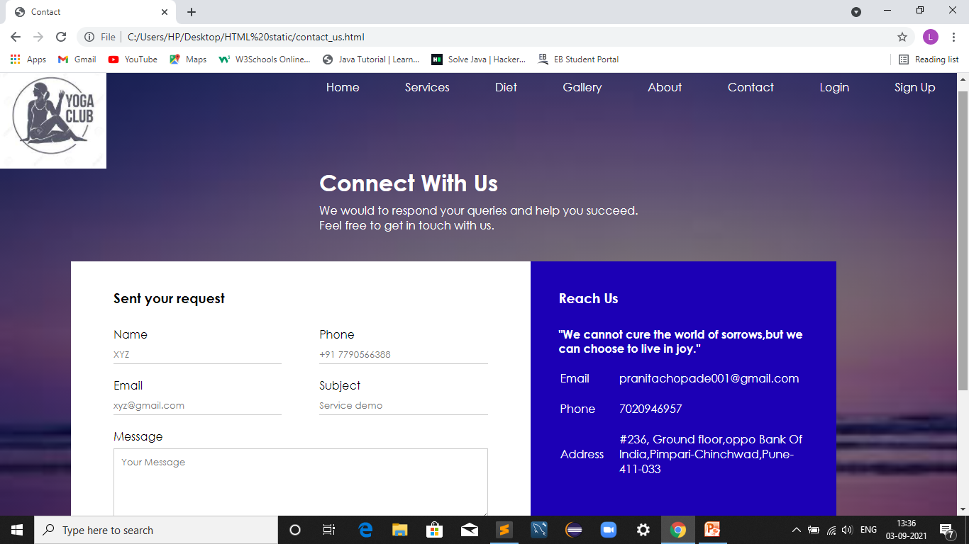
Contact Us Page

Slide 12
Conclusion
The purpose of this website is to make user friendly website.
Make the people tension and stress free in their life.

Slide 13
THANK YOU

